Slide 1
Can We Predict Who Will Leave?

Slide 2
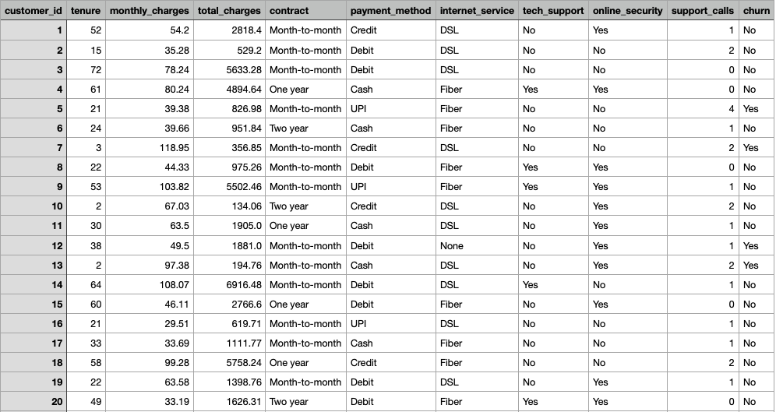
Telco Customer Churn
** Every Prediction Starts with the Data We Understand **

Slide 3
Key Features of the Dataset
Total Rows
Total Columns
Types of Features (numerical vs categorical)
Key Features
The Target (Churn)

Slide 4
Preparing the Data
Checking for Missing Value
Dealing with Duplicates
Converting Categorical Features into Numerical ones
Detecting outliers

Slide 5
Exploring Feature Relationships
Churn Distribution
Tenure vs Churn
Monthly Charges vs Churn
Contract Type vs Churn

Slide 6
From Data to Predictions
Splitting the Data: Train and Test

Slide 7
Battle of the Models
Which one Predicts Best:
Logistic Regression
Decision Tree
Random Forest
Stochastic Gradient Descent
Support Vector Machine

Slide 8
And the winner is ...
Stochastic Gradient Descent model wins, identifying 96% of churned customers.
Close behind: SVM at 94% and Random Forest at 93%.
Since recall matters most, we recommend SGD or SVM, both top performers!

Slide 9
Fine Tunning the Models
Optimizing Parameters, GridSearchCV
The Impact of Tunning
Initial recalls were overfitted
Logistic Regression dropped from 91% to a realistic 53%
Decision Tree settled at 67% after tuning
Tuning provided more realistic performance measures

Slide 10
Feature Impact
Removing Payment_Method improved recall by 1-3%
Simplification helped models focus on stronger predictors
More Streamlined and Generalizeable Models

Slide 11
Precision Through Simplicity
Removing non-impactful features sharpened model focus
Simpler models delivered better recall with fewer distractions
Streamlined features, stronger results

Slide 12
If one change had impact, imagine what simplifying everything could do for your organization.

